Slide 1
Hybrid Motor Modeling
Benjamin Klammer

Slide 2
Why modeling?
Important for initial and conceptual design
How do we know how the motor will work before testing?
Lets us expand test results beyond their scope
Apply static test data (half scale) to full scale flight engine design
Cheaper and safer than testing
Can perform sensitivity analysis to determine most important parameters
Easy exploration of design space allows for optimization
“All models are wrong, some are useful” – George Box
Models must ALWAYS be validated and tuned with real world results

Slide 3
Hybrid Rocket Modeling at UVR
Steady-state spreadsheet based model
Assumes all values constant with time, combustion from RPA
Easy to use, good for initial design, not very accurate for flight motors
Can be configured as design code or design-driven model
Quasi-steady MATLAB based model (MuleSim3.m)
Parameters vary with time, combustion from CEA
More accurate, slightly more difficult to use
Design-driven model

Slide 4
Steady-state spreadsheet model
Category | Parameter | Symbol | Value (SI) | Units (SI)
Constants and Reference Values | Gravitational Acceleration | g | 9.81 | m/s^2
 | Temperature - Ambient | T_amb | 292 | K
Propellant Data | Density Paraffin Wax | ro_paraffin(s) | 900 | kg/m^3
 | Density N2O liquid | ro_N2O(l) | 785.1 | kg/m^3
Motor Performance Parameters | Delivered Thrust | F_T_del | 1037 | N
 | Delivered Thrust - Pc_act | F_T_del_P_c_act | 1080 | N
 | Burn Duration Required | t_burn_reg | 5.00 | s
 | Combustion Chamber Pressure | p_c | 3.23E+06 | Pa
 | Combustion Chamber Pressure - Calculated | p_c_act | 3.365E+06 | Pa
Nozzle Parameters | Nozzle Area Ratio | A_e/A_t | 3.5 | -
 | Nozzle Throat Diameter | D_t | 0.017 | m
 | Nozzle Throat Area | A_t | 0.00022698 | m^2
Injector Parameters | Injector orifice diameter | d_inj | 0.0015 | m
 | Number of infector orifices | n_inj | 6 | -
 | Injector area | A_inj | 1.06029E-05 | m^2
 | Discharge Coefficient | C_D | 0.66 | -
Tank Parameters | Tank Pressure | p_tank | 4.83E+06 | Pa
Combustion Chamber Geometry | Diameter - Fuel grain port initial | D_p,i | 0.0254 | m
 | Area - Grain Port Initial | A_p,i | 0.0005 | m^2
 | Length of fuel Grain | L_grain | 0.5588 | m
 | Diameter - Fuel grain port final | D_p,f | 0.0662 | m
 | Area - Grain Port Final | A_p,f | 0.0034 | m^2
 | Required Remaining Fuel Wall | T_wall_req | 0.008 | m
 | Outer Diameter - Fuel Grain | D_grain | 0.0822 | m
Mass and Mass Flow | Mass flow - Ox | m_dot_ox | 0.350 | kg/s
 | Mass flow - fuel | m_dot_f | 0.164 | kg/s
 | Mass flow - fuel | m_dot_f | 0.295 | kg/s
 | Oxidizer Fuel Ratio | OF | 2.142 | -
 | Mass - Ox | m_ox | 1.752 | kg
 | Mass Flux - Ox (inside fuel grain port) | G_ox | 691.360 | kg/sm^2
 | Mass flow - Total - Actual | m_dot_T_act | 0.514 | kg/s
Regression Rate | Regression Rate Constant | a | 0.155 | m^3/kg
 | Regression Rate Exponent | n | 0.5 | -
 | Regression Rate | r_dot | 0.0041 | m/s
Performance Parameters - Expected (Paraffin = C20H42) | Characteristic Velocity - Optimum Expansion | C* | 1486 | m/s
 | Specific Impulse - Sea Level | I_sp | 214 | s
 | Thrust Coefficient Actual - Sea level | C_T | 1.41 | -
Input:
Motor design (fields shown in yellow and green)
Fuel grain geometry
Nozzle geometry
Oxidizer tank pressure and injector geometry
Combustion chamber pressure
Burn time
Output:
Motor performance (Fields shown in dark blue)
Thrust, total impulse, and specific impulse
Combustion chamber pressure(updated iteratively to arrive at solution)
Final fuel grain geometry
Oxidizer to Fuel Ratio

Slide 5
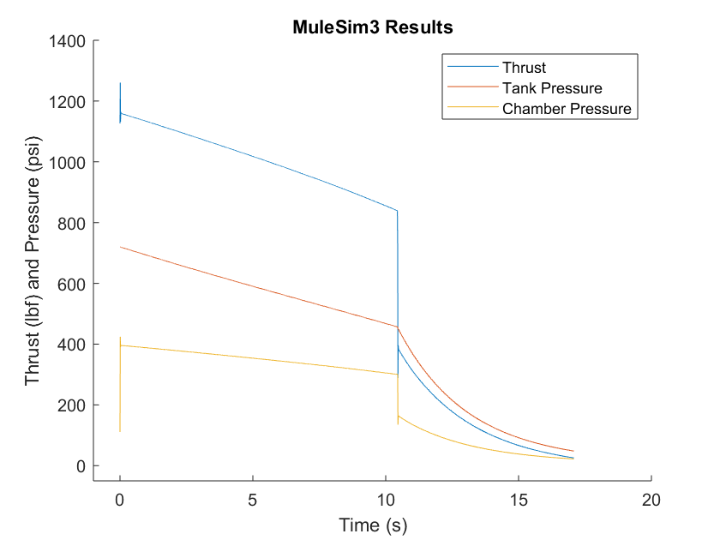
Quasi-steady MATLAB model
Input: Motor Design (green), initial conditions (blue), model parameters (gold)
Tank and injector geometry, fuel grain geometry, nozzle geometry
Output: All calculated values as functions of time
Thrust curve and total mass as function of time for trajectory analysis
Parameter | Symbol | Value | Units
Tank Volume | V_tank | 0.02981 | m^3
Initial Mass of Oxidizer in Tank | m_ox_tank_init | 20 | kg
Initial Oxidizer Tank Pressure | p_tank_init | 4964000 | Pa
Injector orifice diameter | d_inj | 0.003048 | m
Number of Injector Orifices | n_inj | 12 | -
Injector discharge coefficient | Cd_inj | 0.5 | -
Fuel Grain Length | L | 0.4191 | m
Fuel Grain Initial Diameter | d_port_init | 0.055 | m
Density of Fuel | rho_f | 930 | kg/m^3
Fuel Grain Mass | m_f_init | 5.5 | kg
Regression Rate Constant | a | 0.0002 | m/s
Regression Rate Exponent | n | 0.5 | -
Nozzle Throat Diameter | d_th | 0.0407162 | m
Nozzle Area Ratio | A_ratio_nozzle | 5 | -
Atmospheric Pressure | p_atm | 101325 | Pa
Initial Combustion Chamber Pressure | p_cc_init | 101326 | Pa
Initial Combustion Chamber Temperature | T_cc_init | 292 | K
Time Step | del_time | 0.01 | s
Max Burn Time | time_max | 20 | s
Tank Volume Error | V_tank_eps | 0.00002981 | m^3
Tank Internal Energy Error | u_tank_eps | 1000 | J/kg
Nozzle Area Ratio Error | A_ratio_nozzle_eps | 0.001 | -

Slide 6
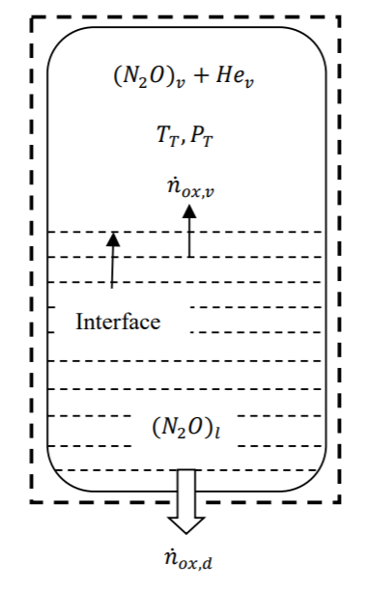
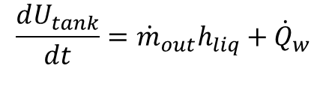

Self-pressurizing Oxidizer Tank
Saturated Liquid and Vapour – Homogeneous Model
Assume fluid in tank is in equilibrium and saturated
Two differential equations, mass and energy
No explicit function for temperature, calculated iteratively from internal energy and tank volume
Mass flow out is determined by injector model
$$\frac{dU_{tank}}{dt}={\dot{m}}_{out}h_{liq}+{\dot{Q}}_{w}$$
$$\frac{dm_{tank}}{dt}={\dot{m}}_{out}$$

Slide 7
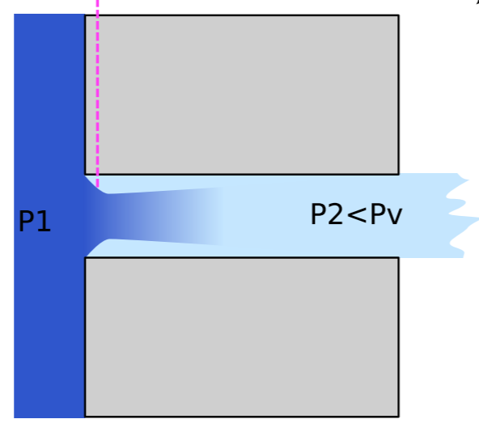



Injector Model
Nitrous oxide leaves injector as saturated liquid
Any decrease in pressure causes cavitation -> two phase flow
Take weighted average of single-phase-incompressible (SPI) model and homogeneous equilibrium model (HEM)
Use SPI to calculate mass flow after liquid is gone
$${\dot{m}}_{SPI}=C_{d}A_{inj}\sqrt{2ρ_{1}(p_{1}−p_{2})}$$
$${\dot{m}}_{HEM}=C_{d}A_{inj}ρ_{2}\sqrt{ 2(h_{1}−h_{2})}$$
$${\dot{m}}_{out}=\frac{{\dot{m}}_{SPI}+{\dot{m}}_{HEM}}{2}$$

Slide 8
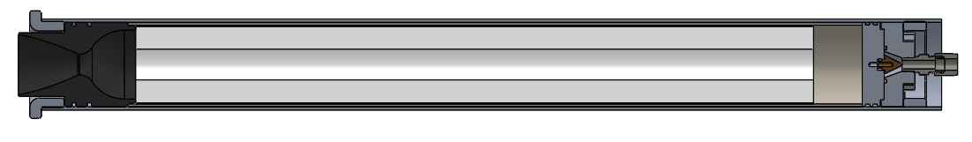
Combustion Chamber Assumptions
CC bounded by:
Pre-combustion chamber
Oxidizer inflow properties
Post-combustion chamber/nozzle
Fuel grain port walls
Fuel mass flow from walls
CC assumptions:
Working fluid in CC is
Ideal gas
Homogeneous
Mixes instantaneously
* Assume Combustion happens much faster than changes in oxidizer mass flow from tank
Flow in CC is
Steady*
Inviscid
Axial
Pre-combustion Chamber
Fuel Grain
Nozzle
Combustion Chamber Model Control Volume (surrounded in red)

Slide 9
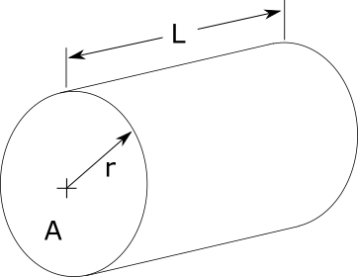
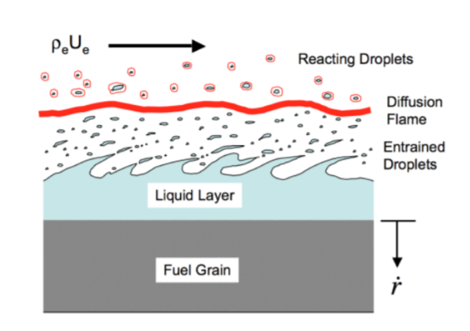

Regression Model
Regression rate
Rate at which the fuel grain port radius increases
Important measure of hybrid motor performance
Generally a function of:
Fuel and oxidizer combination (a, n)
Mass flux through port (G)
$$\dot{r}= aG^{n}$$

Slide 10
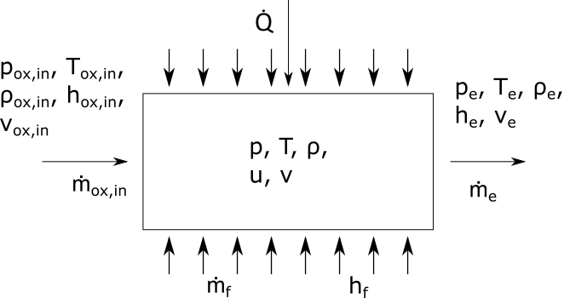
Combustion
Mass Balance
Unsteady, for each species individually
Inputs: ṁ_{e}, ṁ_{f}, ṁ_{ox,i}, v, O/F, p, MuleSimCEA
Outputs: dm_{k}/dt, dm/dt
Energy Balance
Unsteady,
Inputs: ṁ_{ox,i}, h_{ox,i}, v_{ox,i}, ṁ_{f},
h_{f}, ṁ_{e}, v, h, Q, dv/dt
Outputs: dE/dt, dT/dt

Slide 11
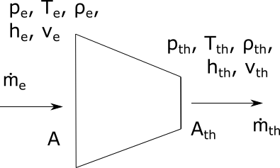
Nozzle Model
Combustion chamber state properties
Ideal gas law
Inputs: m_{k}, T, r
Outputs: ρ, h, R, c_{p}, c_{v}, k, u, p
Nozzle model
Ideal nozzle, choked flow, constant specific heats
Inputs: T, v, c_{p}, R, k, ρ
Outputs: ṁ_{e}, v, dv/dt

Slide 12
Input
“MuleSim3.m” accepts two input files that must be saved in the same folder as the MATLAB function file:
CEA (default ‘MuleSim3CEA.mat’)
MATLAB structure containing thermodynamic properties of combustion fluid (T, M, for various O/F and pressures
Created from CEA output file for fuel and oxidizer using “CEAtoMATLAB.m”
input (default ‘MuleSim3INPUT.xlsx’)
Spreadsheet containing geometry, time, regression, init. cond., etc.
Adjusted manually in excel

Slide 13
Chemical Equilibrium with Applications (CEA)
Computer program written by NASA that does thermodynamic calculations
Used to determine properties of the combustion fluid at various O/F and pressures
Allows model user to change composition of fuel/oxidizer (i.e. to change from pure paraffin to 90% paraffin, 10% carbon black)
Sample CEA Input Code:
reac
oxid N2O wtfrac=1 t(k)=298.15
fuel C32H66(a) wtfrac=1 t(k)=298.15
prob case=MuleSimData1 hp p(bar)=30 o/f=9
output siunits massf short
end
CEA user manual can be found online:
https://www.grc.nasa.gov/www/CEAWeb/RP-1311-P2.pdf

Slide 14
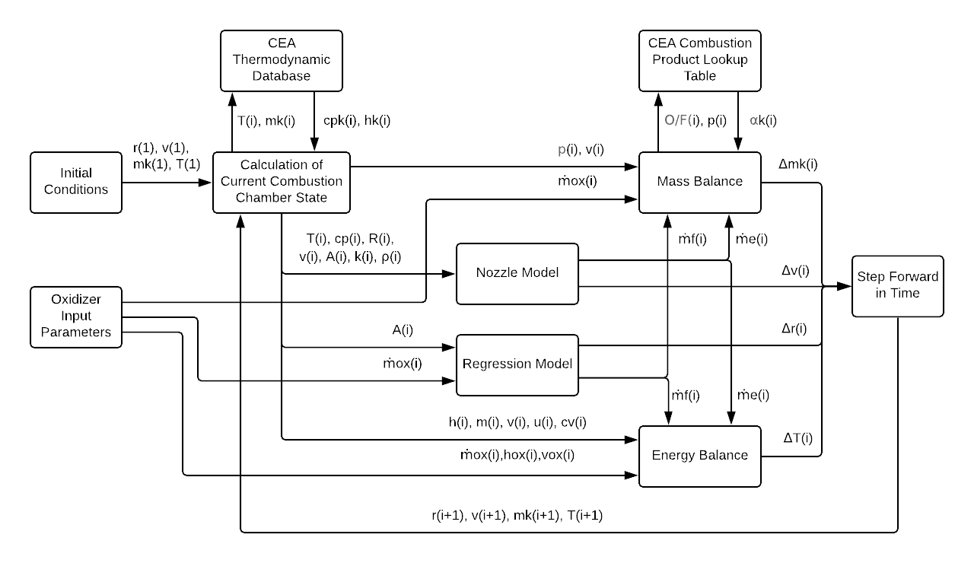
Model Structure

Slide 15
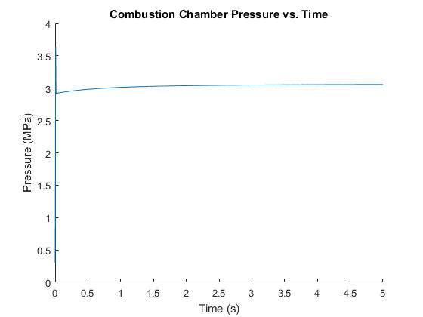
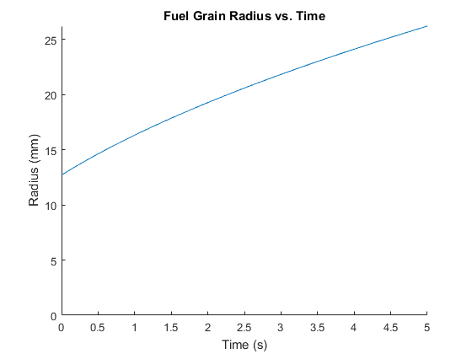
Output
Output includes:
Array of any variable used in calculations
Graphical plots against time
Main variables of interest include:
Pressure
Temperature
Fuel grain port radius
O/F ratio

Slide 16
Discussion of errors
Very good agreement with Stanford-NASA for final fuel grain port diameters
Poor agreement with steady-state spreadsheet/RPA model
Changing regression rate not modeled by spreadsheet
Affects O/F ratio, which affects RPA calculations
Some simulations had initial decrease in temperature to 0K
Does not model condensation/freezing
Artefact of choked flow assumption?
Weird steps in the graphs for simulations with n≠0.5 (i.e. GOX-paraffin)
Due to discrete lookup table for O/F, pressure ratios, try interpolation
Most of the run time goes to thermodynamic property calculations

Slide 17
Future Work (a.k.a. lots)
Improving speed/accuracy of model
Quasi-steady implementation – faster, more stable
Interpolation from lookup table – No discontinuities
Improve thermodynamic property calculation efficiency – faster
Include momentum balance
Related projects
Oxidizer tank model – Calculate oxidizer inflow properties
Nozzle model – Calculate thrust
Hot Static Test design and analysis – Use model to find parameters to vary
Flight engine design

